Slide 1
Opioid Crisis
Joy Gao, Harshini Thambiah, Jeremy Chen, Sarah Dunn,
Notes:
Sarah

Slide 2
Meet the Team
Harshini Thambiah
Data Visualization
Joy Gao
Web Programming and Design
Jeremy Chen
Web Programming and Design
Sarah Dunn
Web Programming and Design
Notes:
Sarah

Slide 3
The Case
Problem
There are increasing opioid death rates each year
Factors
Geographic location, Prescription rates by doctors, Mental health,
What can we do?
We need increased access to treatment programs
Research alternative methods for pain relief
Notes:
Sarah
Problem - There are increasing opioid death rates each year
Factors - Mental health, Prescription rates by doctors, Geographic location
What else can we do? We need increased access to treatment programs for mental health and addiction.

Slide 4
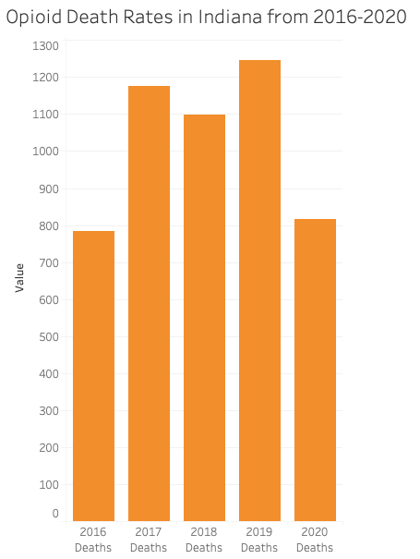
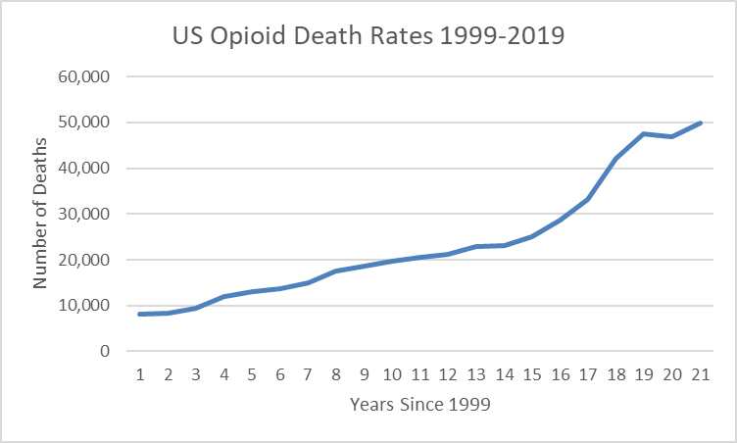
Death Rates Per Year
Source: Drug data
Source: Drug data
Notes:
Harshini
Death Rates Dataset
The line graph shows the increasing amount of opioid deaths years after 1999 in the entire US and so at 2020 the deaths are at an all time high. The amount of deaths is concerning and it is just getting worse. However in the bar graph it shows the Opioid death rates in Indiana, with the highest death rates being in 2019, with the total number being 1246, and the lowest death rates in 2016, the total number being 784 deaths which makes the death rates in Indiana not as high as the total death rates in the US.

Slide 5
Audience
Health Officials
Police
Government officials
Social Workers
Assumptions
Opioid deaths in 2020 went down due to the pandemic
Less people going to doctors, getting prescriptions, going out in general
Notes:
Harshini
Our Audience for our data would be health officials, government officials, police and social workers basically anyone who works in the government. One of our assumptions in our datasets would be that opioid deaths in 2020 went due down most likely due to the pandemic less people going to doctors and getting prescriptions, less people going out in general

Slide 6
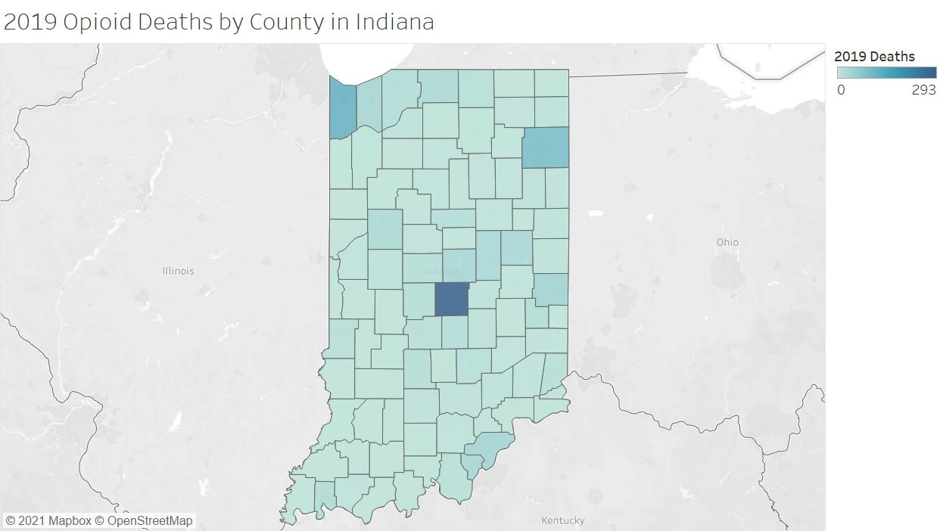
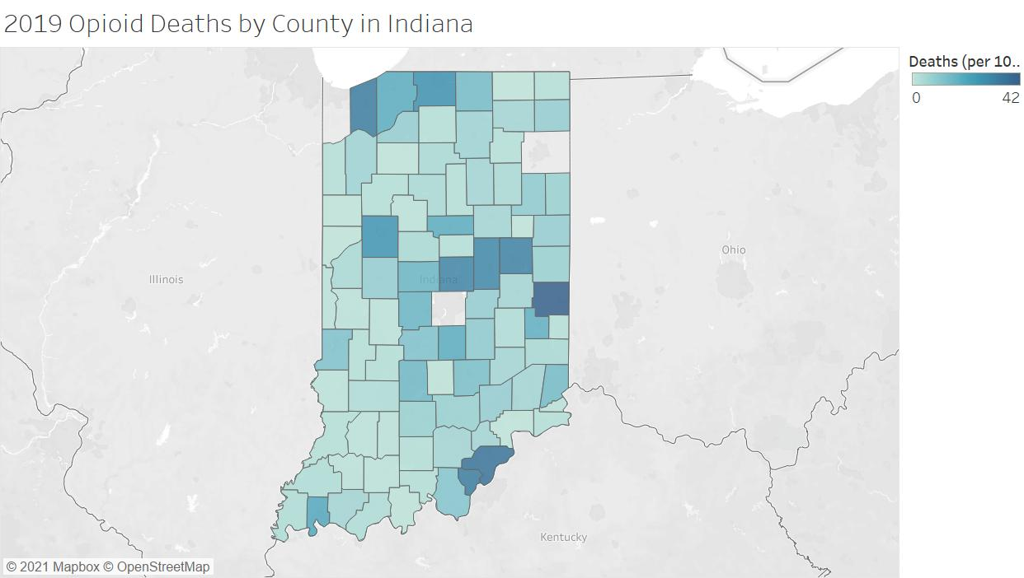
Geographic Location
*per 100,000 population
Data retrieved from; https://www.in.gov/recovery/data/
Notes:
Joy
One contribution to increasing opioid death rates is geographic location. Urban areas have a denser population and there is also increased access to drugs in the cities. Here, in the visualization on the left, the darker shades of blue represented higher death counts, so you can see that in 2019, Marion County in the middle had an extreme difference in deaths than the rest of the counties. Lake and Allen County were the next 2 darkly shaded in the upper 2 corners, which is unsurprising since both are highly populated counties. But since these 3 counties were so high in deaths counts compared to the rest of the counties, it was hard to tell the difference between the shades of my visualization. That is why I decided to exclude these 3 counties in my refined visualization on the right.

Slide 7
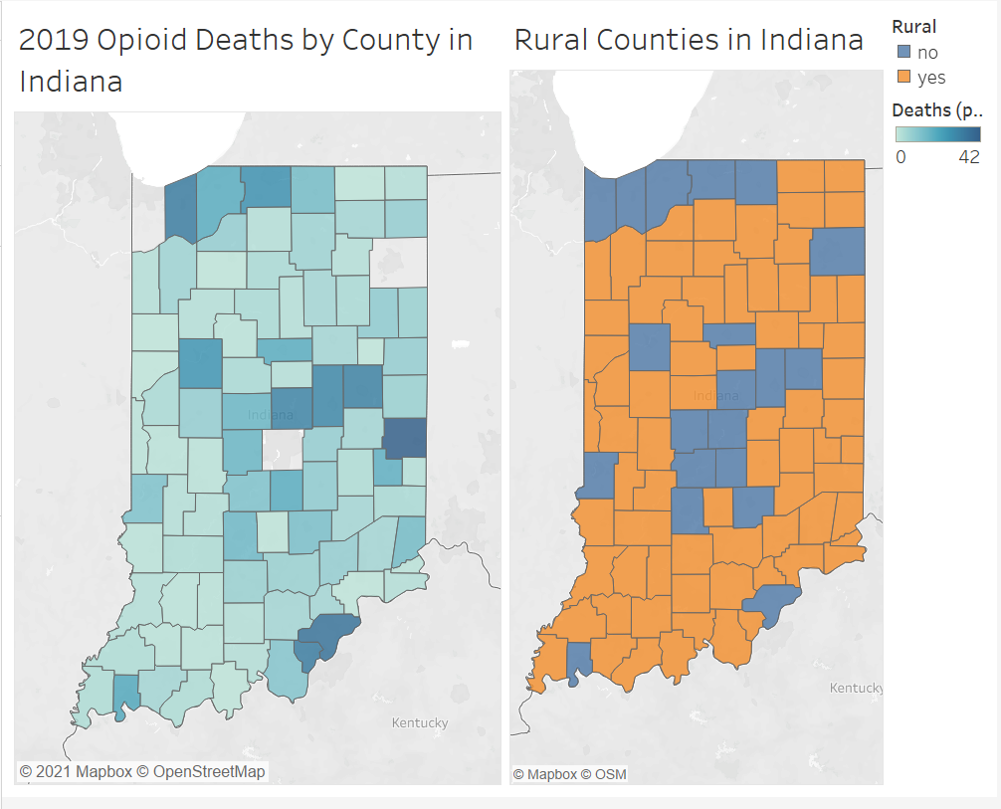
Geographic Location
*per 100,000 population
Data retrieved from; https://www.in.gov/recovery/data/
Notes:
Joy
I then compared the visualization with a map of rural and urban counties. You can see that the orange counties (which are rural) generally correlate with lower death rates shown in the lighter blue on the left. Higher death counts also correlated with the urban counties in blue. As a result, it can be generalized that more people are dying from opioid usage in urban areas.

Slide 8
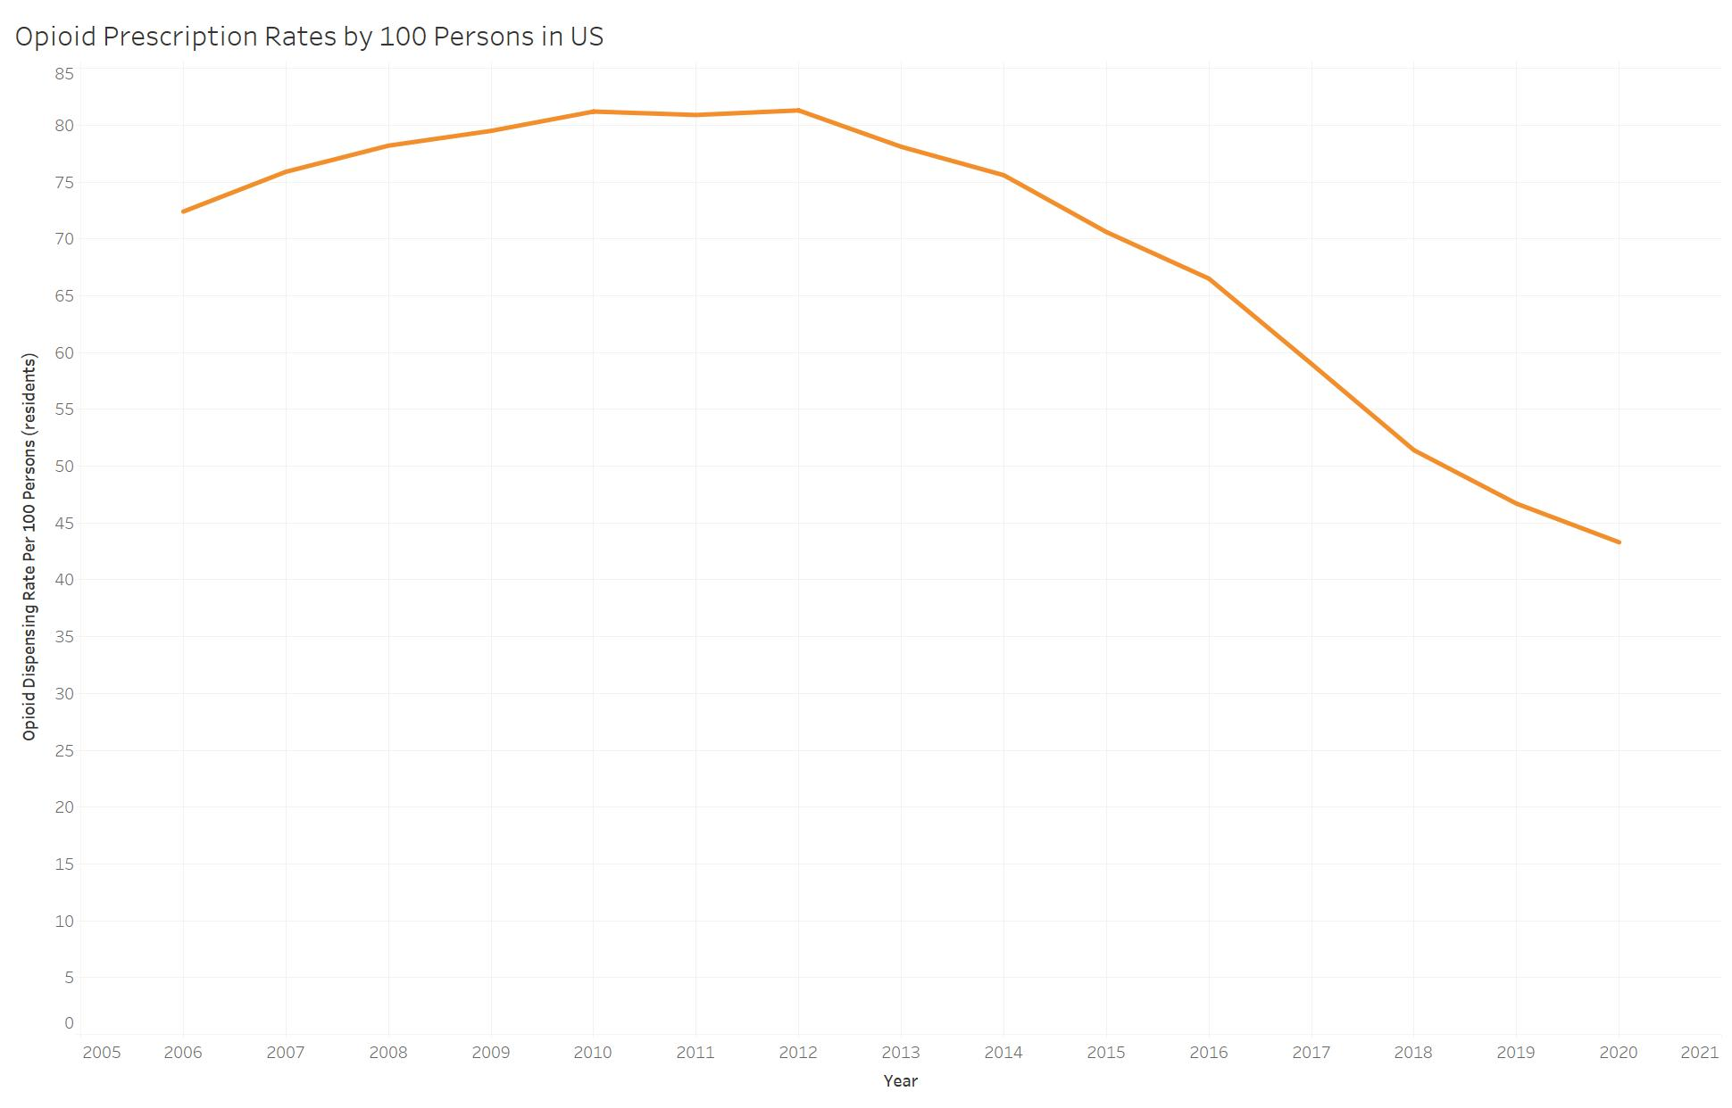
Prescription Rates
Notes:
Sarah
Higher dispensing rates for Opioids can lead to higher amounts of opioid abuse
Even though rates went down drastically in the past few years, many people from the peak remain addicted
Even though the rates dropped in 2020, some counties in the United States had a much higher prescription rate
https://www.cdc.gov/drugoverdose/rxrate-maps/index.html

Slide 9
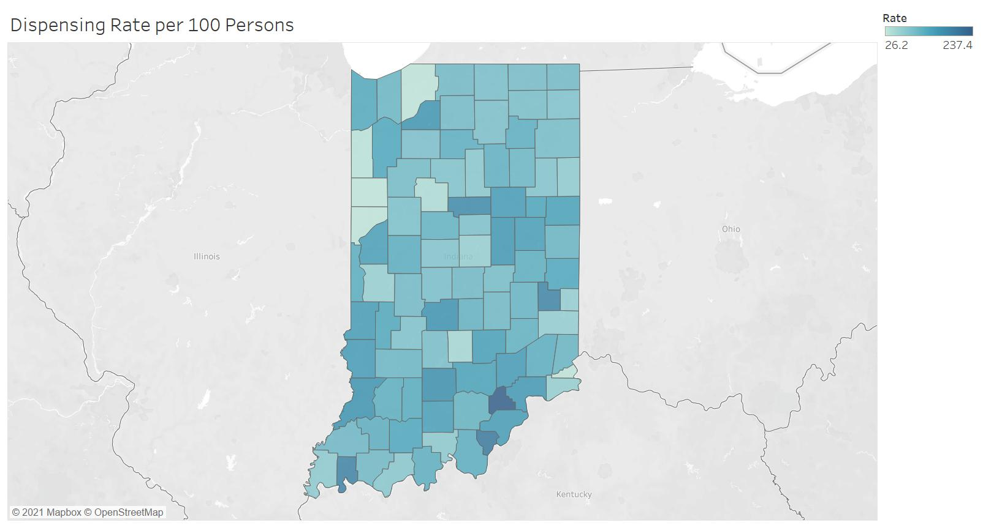
Prescription Rates in Indiana (2012)
Notes:
Sarah

Slide 10
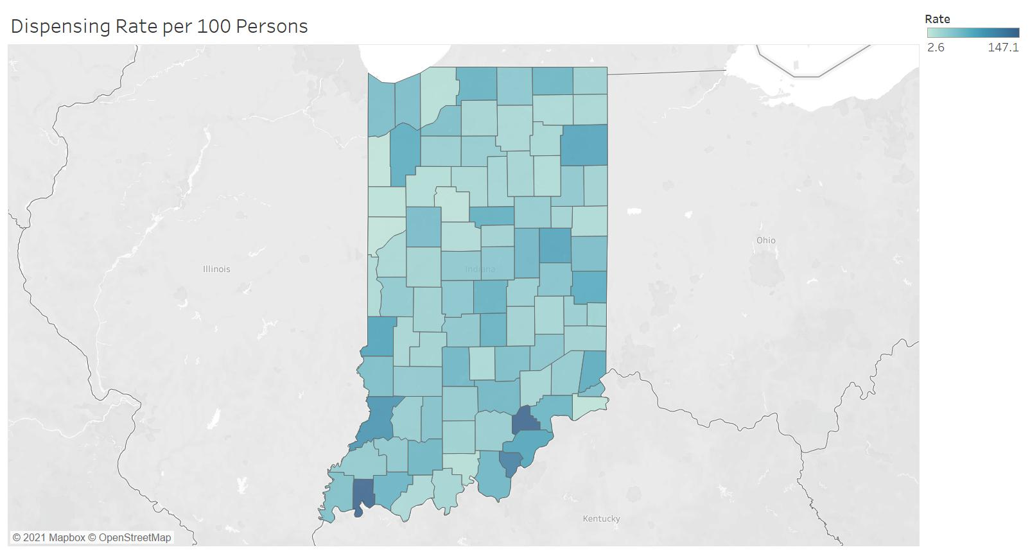
Prescription Rates in Indiana (2020)
Notes:
Sarah

Slide 11
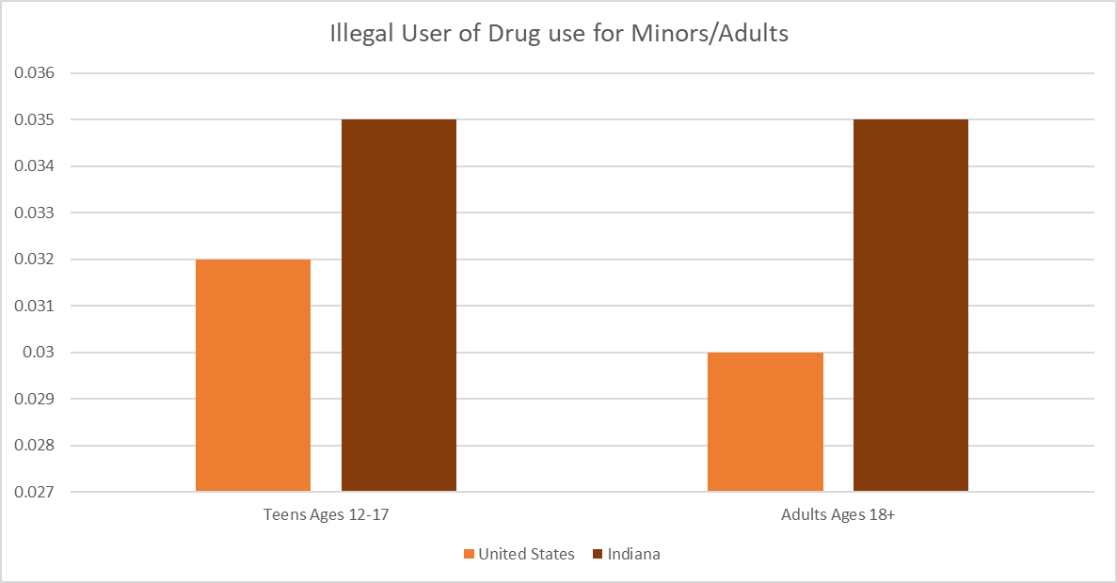
Mental Health Increase Drug Abuse
0.035
0.035
Trauma, such as physical or emotional abuse, can contribute to both mental health conditions and addiction.
0.032
0.03
People with depression and other mental health conditions may self-medicate with opioids to hide their symptoms.
Data retrieved from: https://www.kff.org
Notes:
Jeremy
Mental health can increase drug abuse. Factors like physical or emotional trauma can contribute to people trying to self-medicate.
As well as people with depression and other mental health conditions. They might attempt to self- medicate to make their symptoms not noticeable to others.
From the visualization here it is obvious that teens and adults in indiana has a greater percentage of illegal drug use due to the lack of effective mental health programs.
This data was taken from kff.org and `Deaths due to drug overdose in the U.S. were more than three times higher in the past decade.

Slide 12
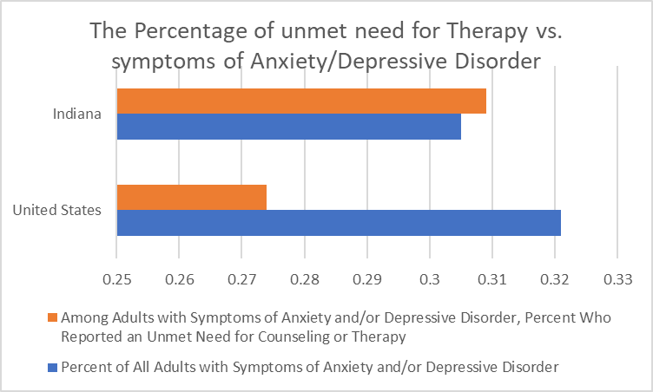
Unmet need for Counseling/Therapy causes Self Treatment
Data from 2018-2019
0.309
0.305
0.273
0.322
Data retrieved from: https://www.kff.org
Notes:
The next visualization is a comparison in percentages of those who do not qualify for treatment and those who have symptoms.
It is obvious that indiana has a serious problem in identifying people who need treatment. This lowers the access to mental health programs and causes people to self medicate. With no guidance people often overdose on drugs to relief from pain.

Slide 13
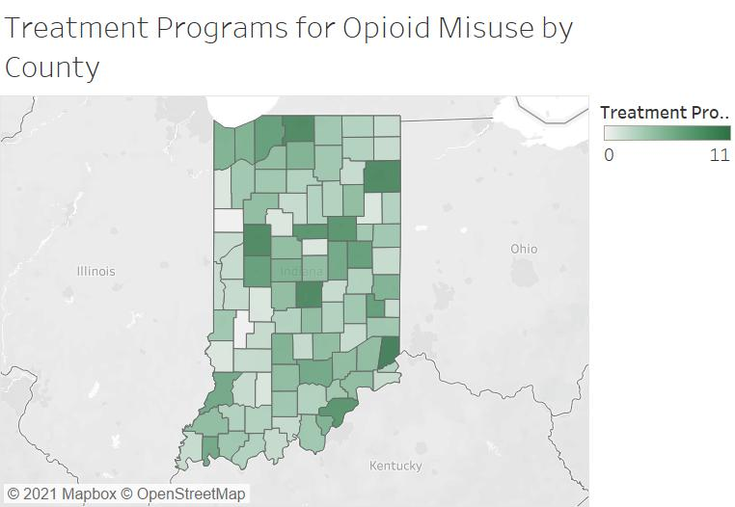
Solution
Need more effective treatment programs in urban areas
Increased access to mental health programs
Promote medication for anti-overdose
Other pain relief methods

Slide 14
References
https://www.kff.org/statedata/mental-health-and-substance-use-state-fact-sheets/indiana/
https://www.in.gov/recovery/data/
https://www.cdc.gov/drugoverdose/rxrate-maps/index.html
https://www2.indstate.edu/news/pdf/2014-08_IN%20Rural_Counties_Economic_Overview.pdf
https://www.drugabuse.gov/drug-topics/trends-statistics/overdose-death-rates
Notes:
Everyone

